Slide 1
Content-Based Movie Recommendation System
By:
Namratha (4nm18cs099)
Nidhi Rai(4nm18cs103)

Slide 2
Abstract :
Used to gain more user attraction by understanding the user’s taste.
Systems that look for similarity before recommending something.
Content based movie recommendation system:
Takes in a movie that a user currently likes as input.
Then it analyzes the contents of the movie to find out other movies which have similar content.
Finally, it ranks similar movies according to their similarity scores and recommends the most relevant movies to the user.

Slide 3
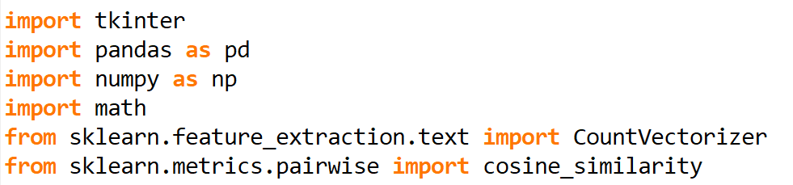
Importing Libraries

Slide 4
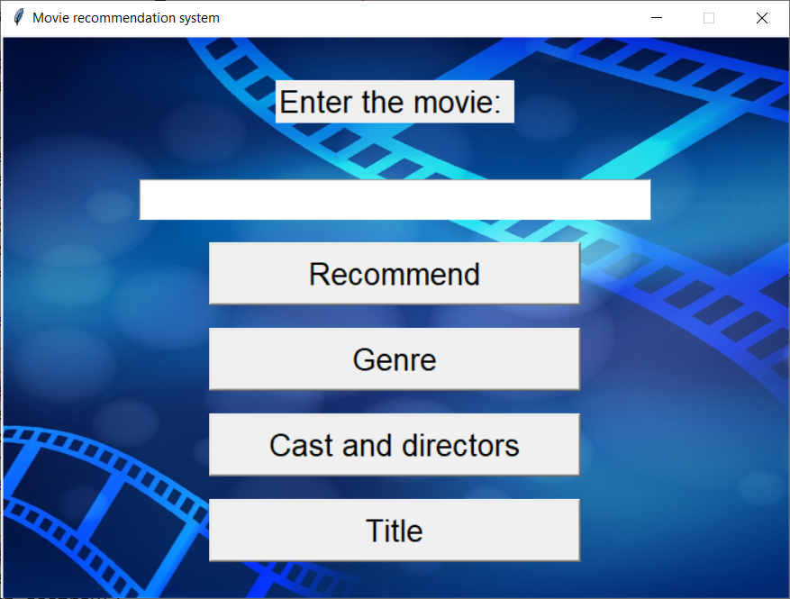
USER INTERFACE

Slide 5
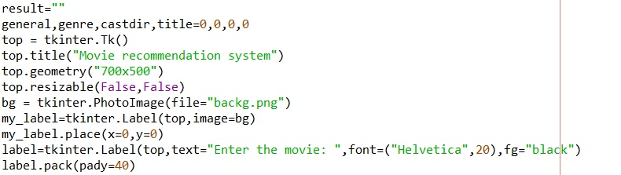
We have designed our GUI using tkinter library

Slide 6
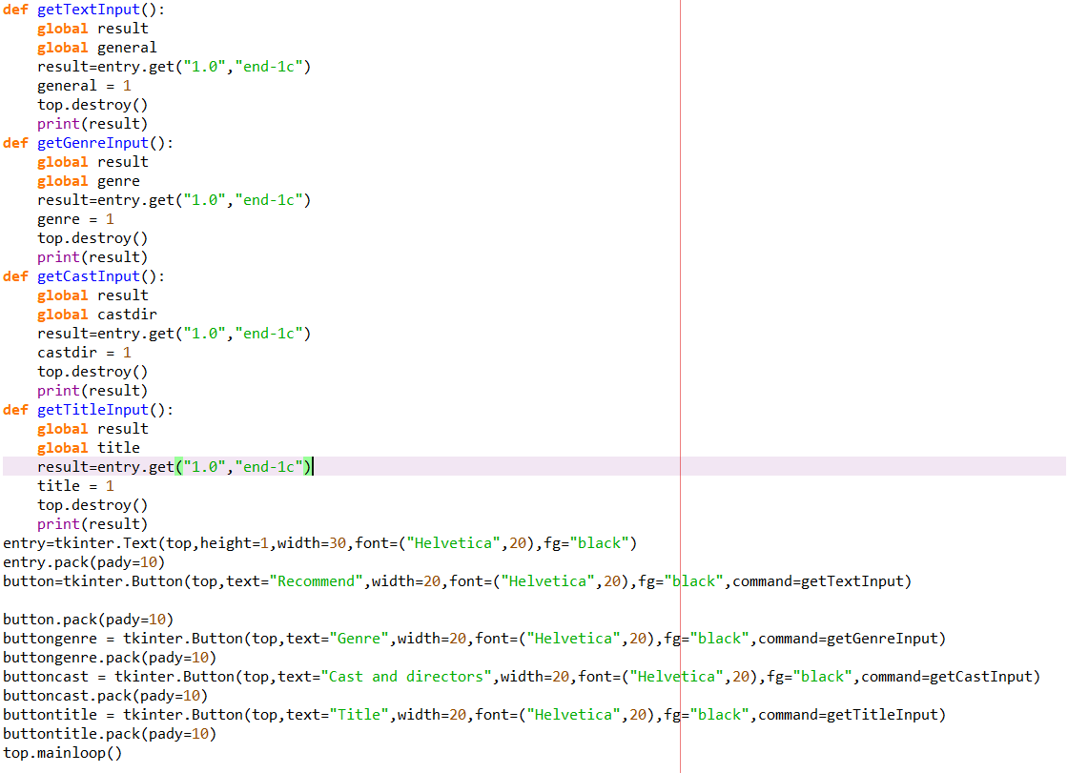

Slide 7
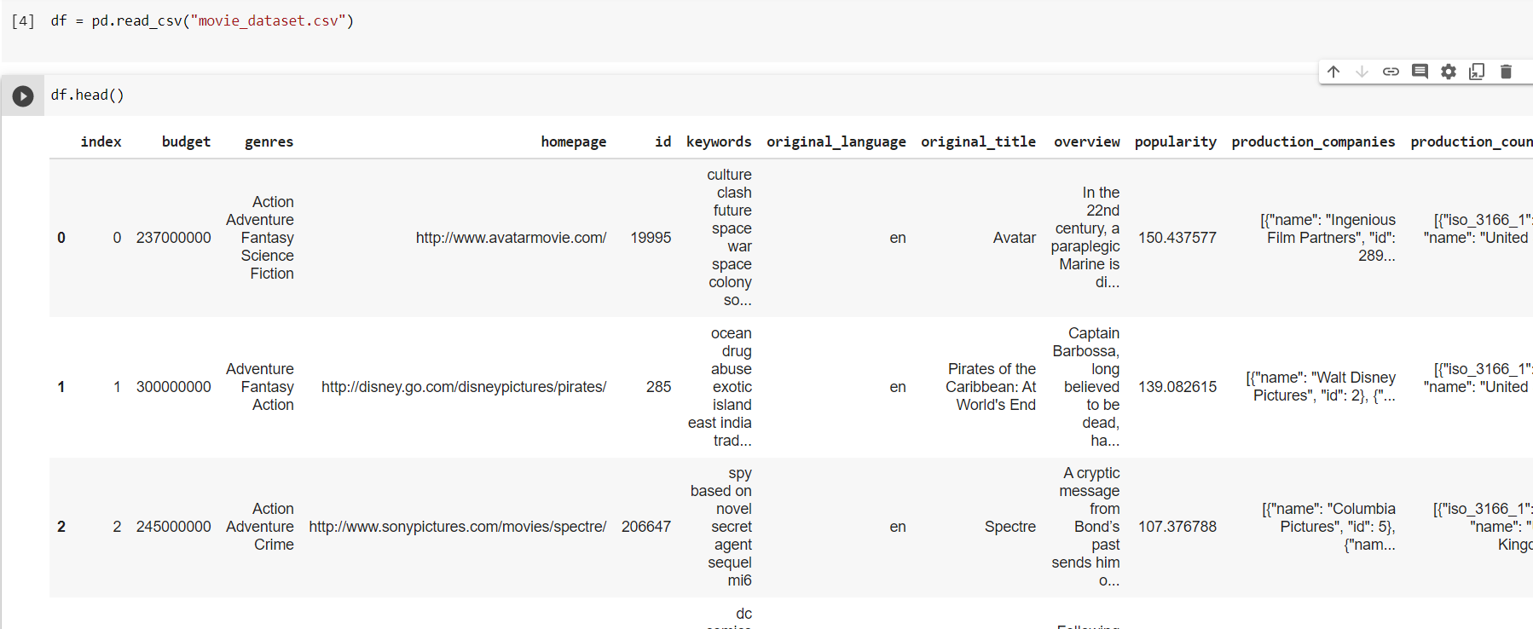
Reading the dataset:

Slide 8
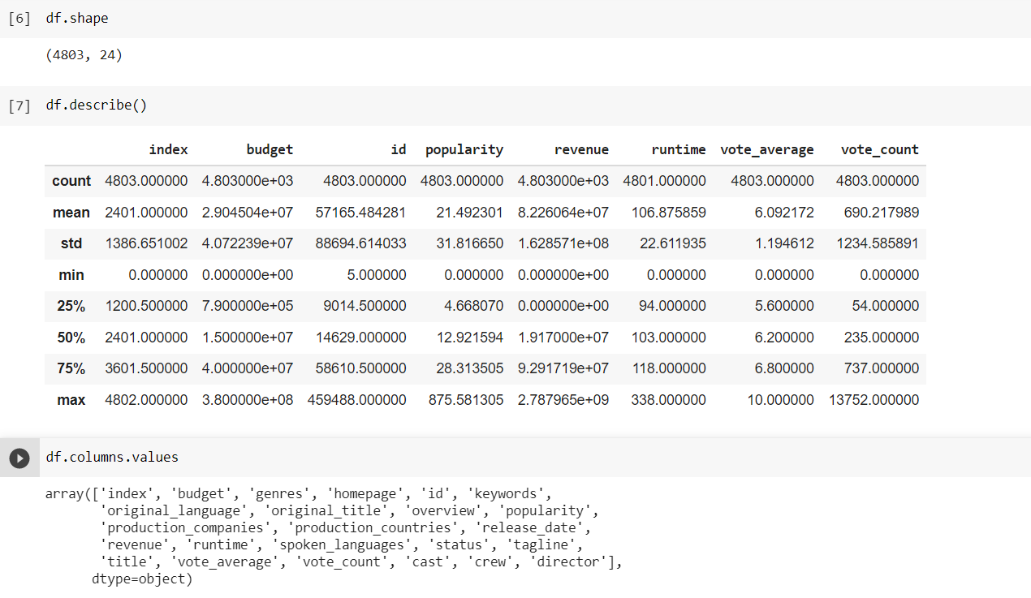

Slide 9
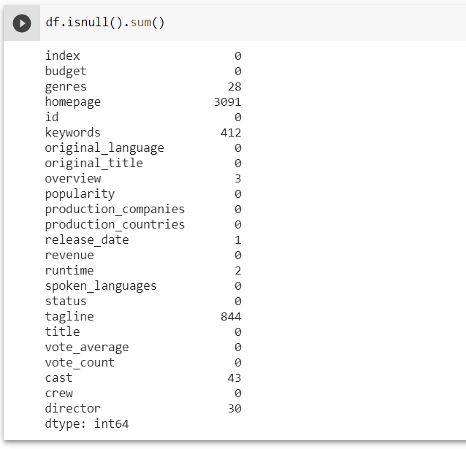
Check for null values:

Slide 10
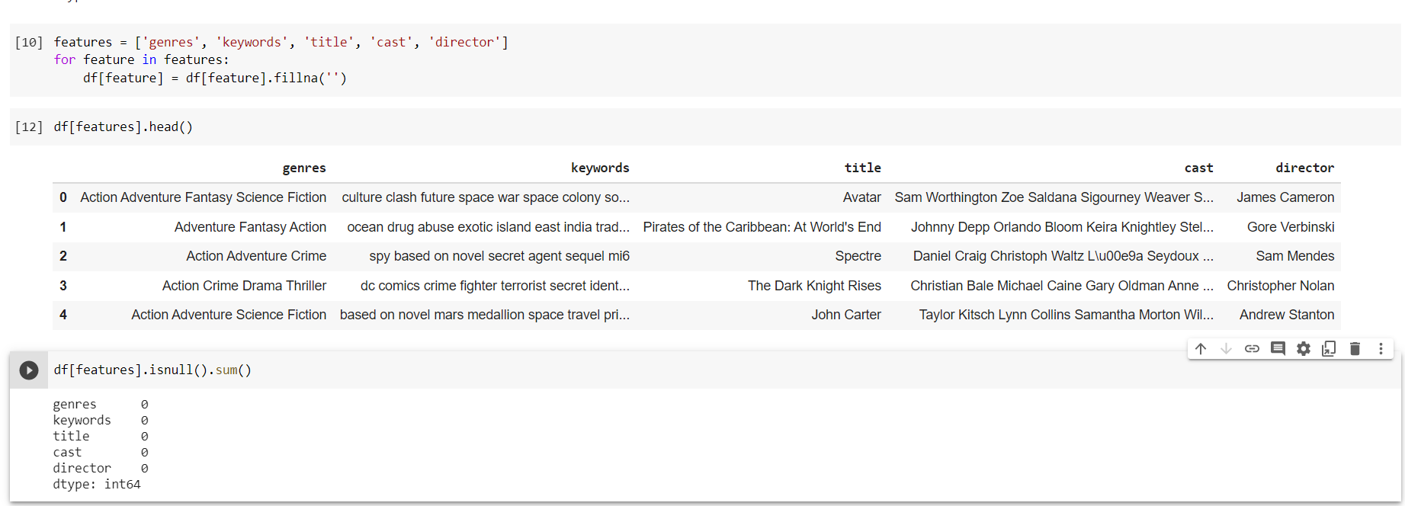
Replacing null values with empty string:

Slide 11
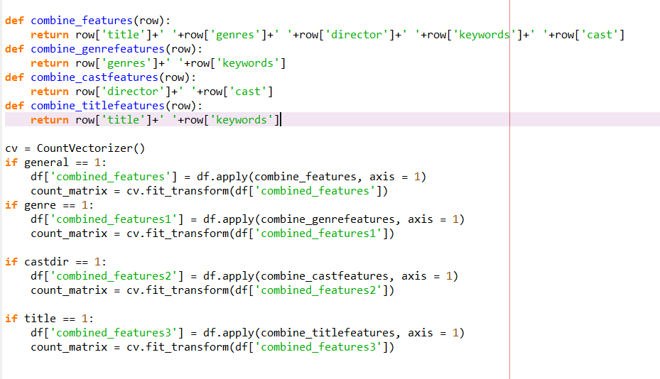
Combining into a single column:

Slide 12
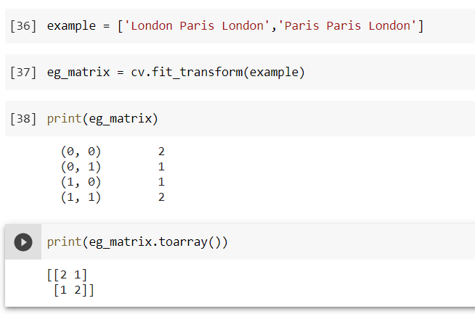
Example for countVectorizer.fit_transform

Slide 13
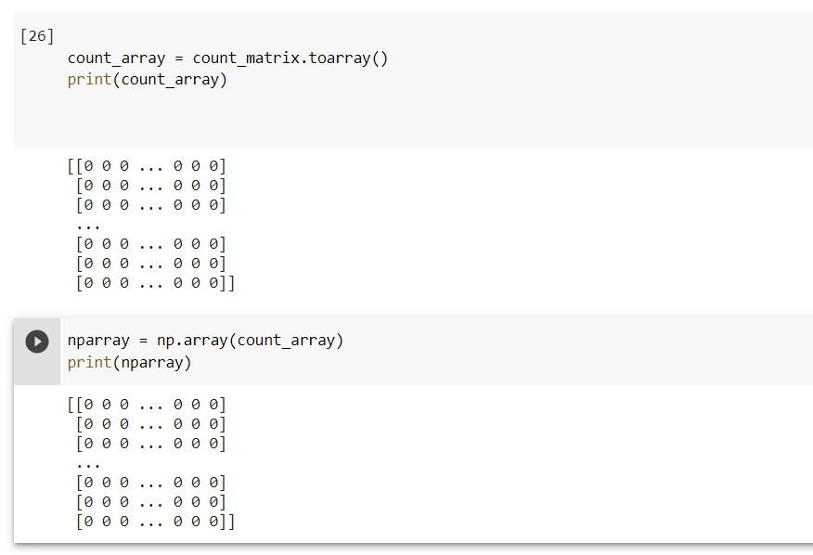
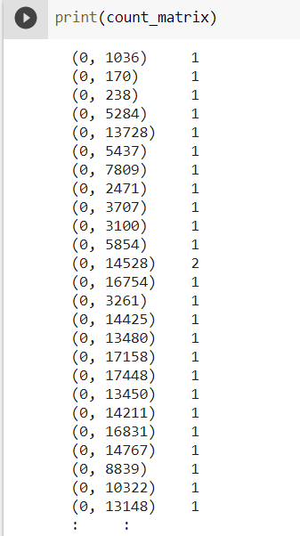

Slide 14
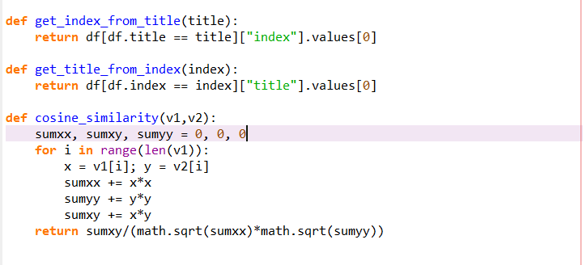

Slide 15
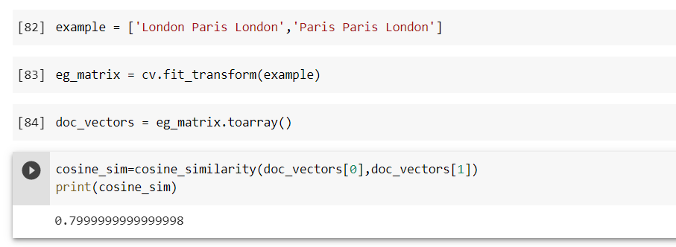
Cosine similarity example :

Slide 16
Thank you

